Slide 1
Project Brief:-
This project was about making a poster.
We had to do 3 rough sketches for the basic idea.
The approved one we had to do digitally .
The poster was based upon Julius Ceaser “S” death
The name of the incident was” Julius Ceaser death at the ides of March”.

Slide 2
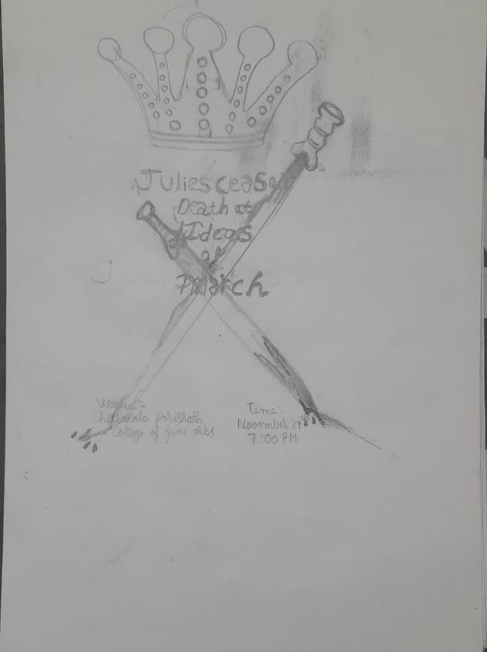
sketches brief:-
This poster sketch shows 2 swords clashing and blood flowing indicaes death and crown right at the top indicates the death of the King

Slide 3
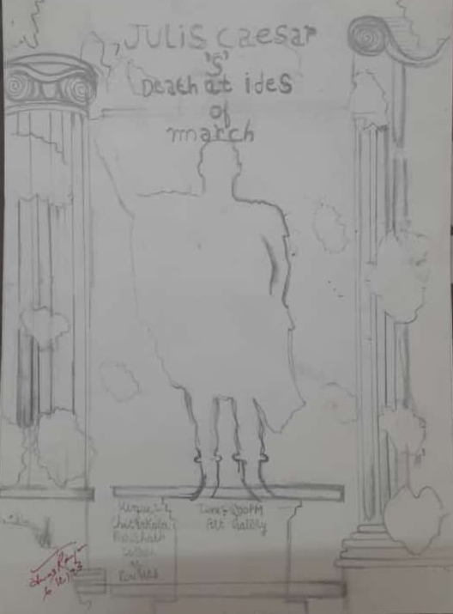
This poster sketch indicates the 2 roman pillars and the statue of Roman emperor Julius Ceaser.

Slide 4
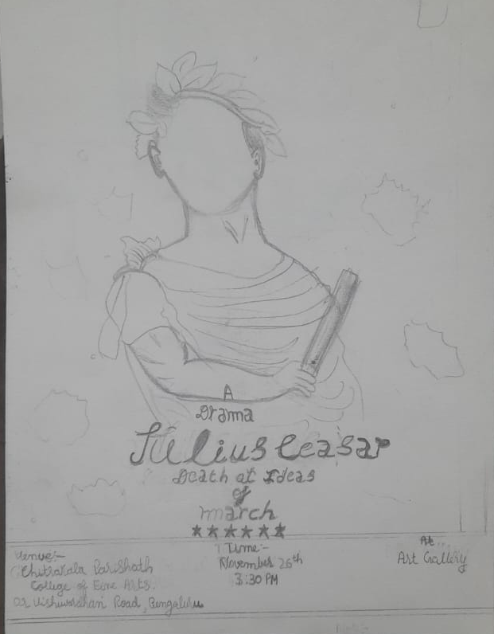
This Sketch shows julius ceaser statue with stars.

Slide 5
Final Digital Poster
This is my digital work showing The Roman dictator Julius Ceaser “S” Statue with Roman Architecture named named Doric coloums.
Colours:-
Typeface:-
Badoni MT
Myraid Pro

Slide 6


